Slide 1

Unveiling the Next Generation Travel Portal
Introducing a revolutionary travel platform designed to empower travelers and curate unique experiences. This innovative portal will serve as a comprehensive resource for discovering hidden gems, planning unforgettable adventures, and connecting with a passionate community of fellow travelers.

Slide 2
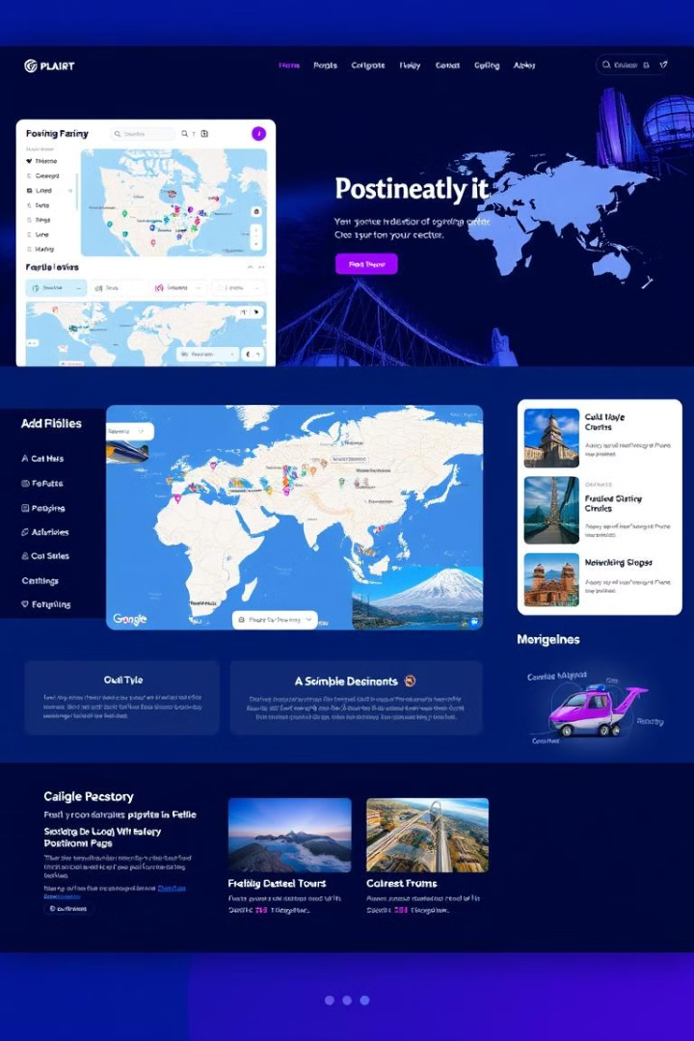
Key Features of the Travel Portal
1
Tourist Spot Discovery
2
Adventure Exploration
Our portal will provide a curated selection of must-visit attractions, including renowned landmarks, lesser-known gems, and unique cultural experiences.
Discover a world of exciting adventures, from exhilarating outdoor activities to thrilling urban explorations, catering to various interests and skill levels.
3
Unexplored Locations
4
Personalized Route Planning
Uncover hidden treasures and off-the-beaten-path destinations, offering a chance to experience unique cultures and immerse yourself in authentic local experiences.
Our intelligent routing system will generate custom itineraries based on user preferences, time constraints, and budget considerations, ensuring an optimized travel experience.

Slide 3
User-Generated Content and Crowd-Sourcing
Community-Driven Content
Crowd-Sourced Data
Interactive Travel Forums
Harness the power of crowdsourcing to gather valuable insights, such as real-time updates on local events, hidden gems, and travel tips, enriching the platform's information database.
Foster a vibrant online community where travelers can connect, share experiences, ask questions, and receive advice from fellow enthusiasts, fostering a sense of belonging and shared passion for travel.
Leverage the collective knowledge and passion of travelers by enabling user-generated content, including reviews, recommendations, and firsthand accounts of destinations.

Slide 4




Personalized Travel Recommendations
User Profile Analysis
AI-Powered Recommendations
Dynamic Itinerary Generation
Gather data on user interests, travel history, budget constraints, and preferred travel styles to create a comprehensive understanding of individual preferences.
Offer personalized itineraries based on user preferences, time constraints, and budget considerations, ensuring an optimized travel experience.
Utilize advanced algorithms to analyze user data and provide tailored recommendations for destinations, activities, and accommodation options that align with their interests.

Slide 5
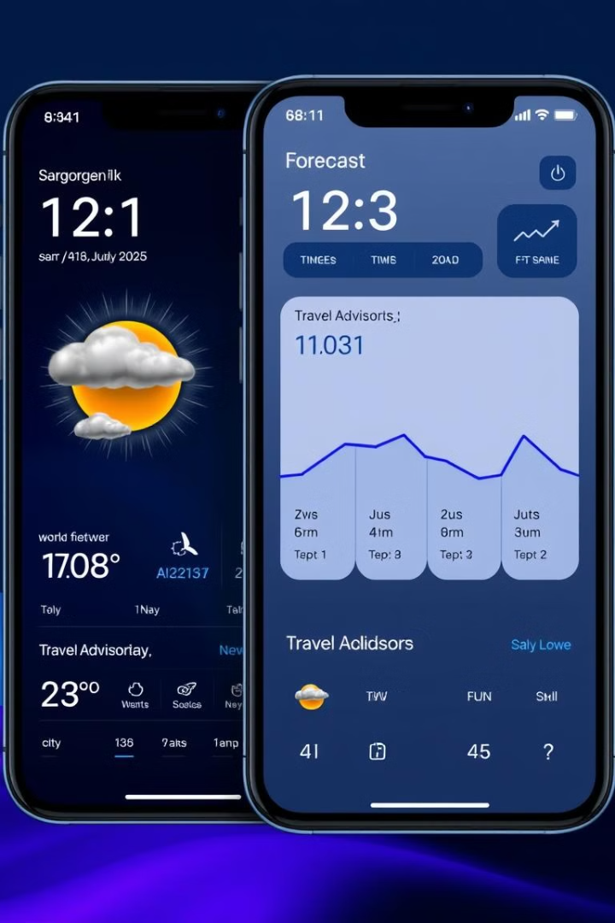
Leveraging Weather and Travel Advisory Data
Weather Data Integration
Real-time weather forecasts and historical data will be incorporated into the platform to provide users with up-to-date information on weather conditions at their chosen destinations.
Travel Advisory Updates
The platform will include access to travel advisory information from reputable sources, ensuring travelers are aware of any potential risks or restrictions related to their chosen destinations.
Dynamic Route Optimization
Weather and advisory data will be used to dynamically adjust recommended routes, ensuring travelers avoid potential disruptions or safety concerns.

Slide 6

Conclusion and Next Steps
Our vision is to create a user-centric travel platform that empowers travelers to explore the world with confidence and excitement. By leveraging advanced technology, crowd-sourced data, and a user-friendly interface, we aim to revolutionize the travel experience.

